Slide 1

Safe Internet

Slide 2



Notes:
Common Searching Sites : Search Engines:

Slide 3
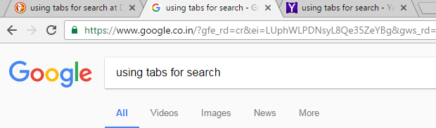
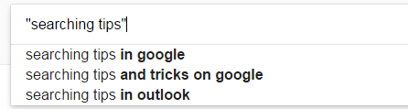
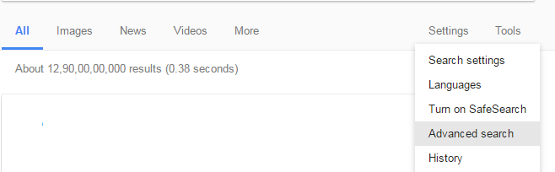

Searching Made Easy
Use the tabs
Update Web browsers regularly and enable security features
Install protective software
Guard personal information
Be wary of Internet downloads
Stick to software from official sites.
Use More than One Search Tools
Use unique, specific terms
Maximize AutoComplete
Set a time limit — then change tactics
Start Simple and Take Advantage of the Search Tool
Keep Wading to a Minimum
Notes:
Searching Made Easy

Slide 4





Searching Made Easy
Use a colon to search specific sites
Use the minus operator (-) to narrow the search
Use quotation marks for exact phrases
Use an asterisk (*) if you don’t know the word
Search a price range for an item (Use two periods (..) between two prices)
Notes:
Searching Made Easy

Slide 5





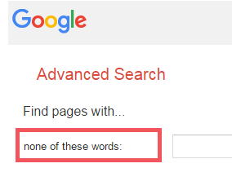
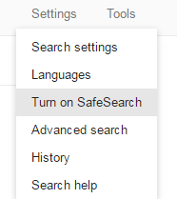

Enable security features
Install protective software
Confirm the authenticity of the site
Update Web browsers regularly
Safe Search
Block words you don't want searching for
Use browser's safest search settings
Guard personal information
Parental/teachers presence when online
Notes:
Safe Searching

Slide 6
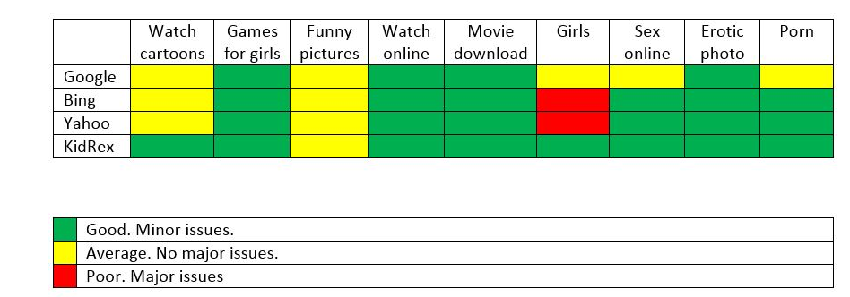



Safe Searching
Courtesy: Kidskaspersky.com
Notes:
Safe Searching

Slide 7
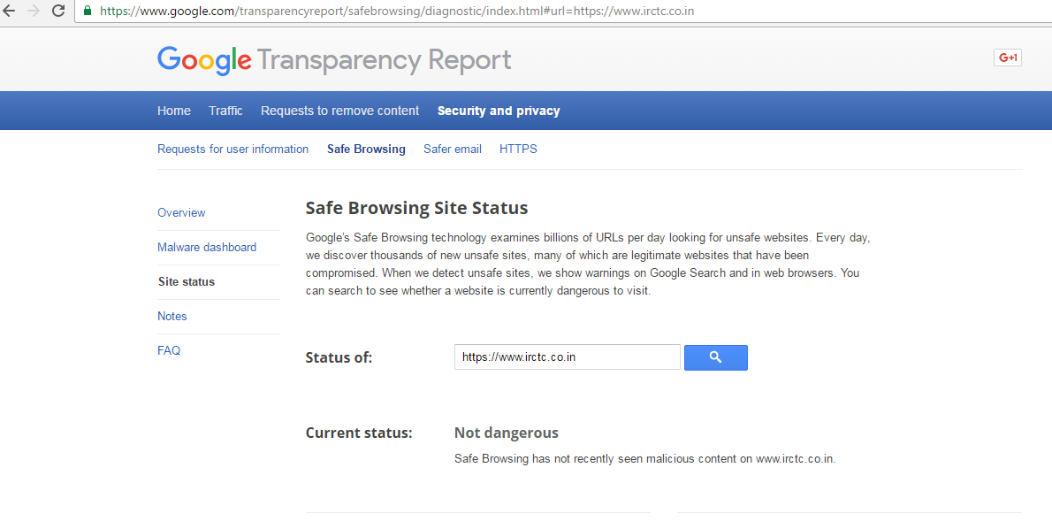
A little known trick is to check with Google’s own servers if a particular site has any record of carrying malware.
Key in the following (without the quotes): “http://google.com/safebrowsing/diagnostic?site=” followed immediately by the name of the site (e.g. “scambusters.org”) and you’ll get what’s called a diagnostic report for the site.
Need to test this out and output to be attached

Slide 8

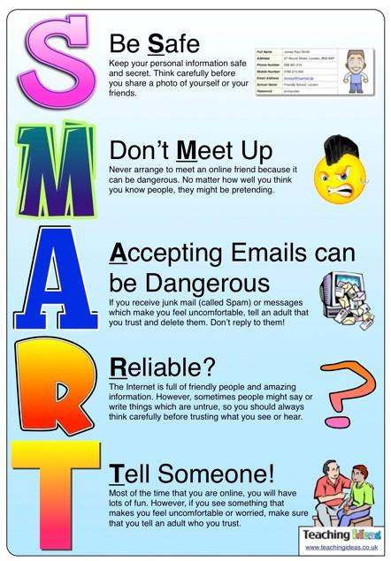



Notes:
Be Safe Be SMART online

Slide 9



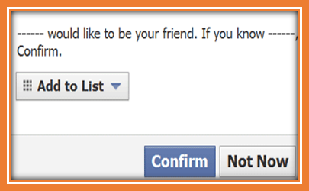

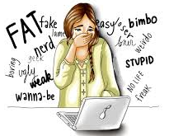
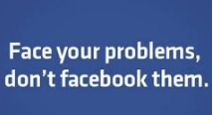

Don’t give out your personal information
Don’t sign up for sites that are 13+ if you are not old enough
Don’t agree to meet someone that you have met online
Don’t add people as online friends unless you know them in real life
Be Online Be Safe
Ensure privacy settings on activated on all of social media websites you use
Know what cyber bullying is and tell someone if you think it’s happening to you
Be careful about discussing your personal problems with online friends
Protect your digital footprint

Slide 10
With freedom and trust comes the expectation that you will act - responsibly
Talk to your parents
Agree to computer rules set up by your parents, teachers or guardians.
If you’re unsure of anything when you are online
Before downloading or installing any software
Treat others online the way you’d like to be treated.
About pictures you want to post online
You cannot believe everything you read on the internet and you can’t trust everything online
When you’re going on online
What you’re doing online
Remember that the rules for online safety also apply to texting on your phone

Slide 11
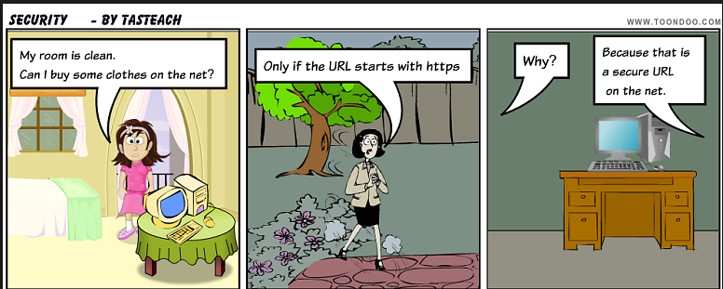
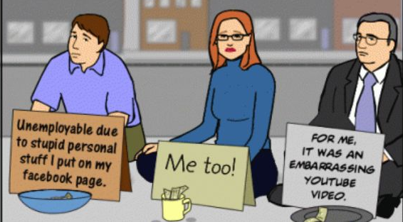

Slide 12

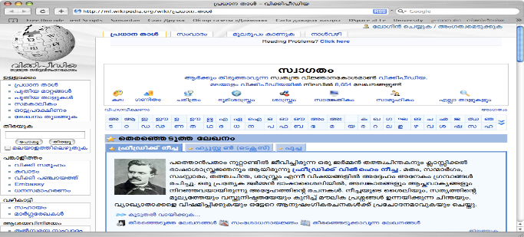

Wikipedia
Free online encyclopaedia
Ranked among the ten most popular websites
Written collaboratively by largely
anonymous volunteers who write without pay
Wikipedia is available in Malayalam
https://ml.wikipedia.org/wiki/
Wikipedia is a free, open content online encyclopaedia
created through the collaborative effort of a community
of users known as Wikipedians. Anyone registered
on the site can create an article for publication

Slide 13

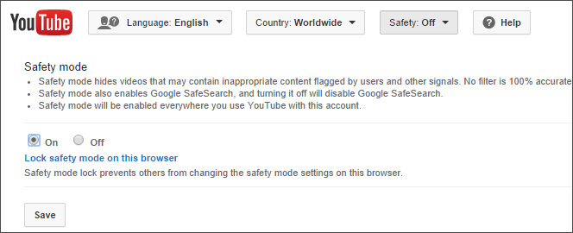
Accentuate the positive
Know what type of content to film and upload
Remember “The Grandma Rule”
Use YouTube’s privacy features
Set up a family account
Turn on Safety mode
Choose carefully
Eschew the Tube
Upload with extreme caution
Post in private
Kill comments

Slide 14
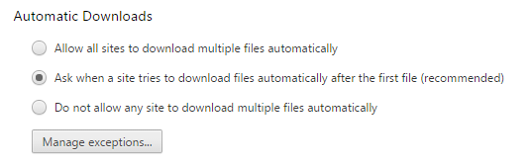
Avoid Automatic Downloads
Stick to Software from Trusted Sources
If Possible, Download Directly from the Software’s Official Site
Use Your Antivirus Software to Check Potential Downloads
Check File Specs for Authenticity
Don’t Download Pirated Apps

Slide 15
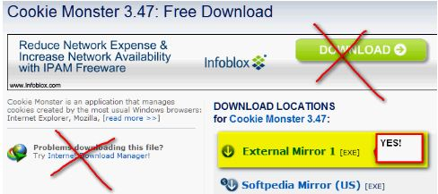
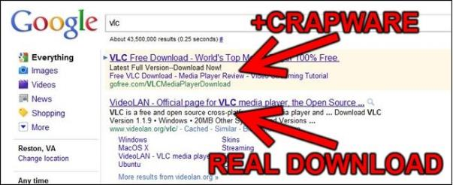

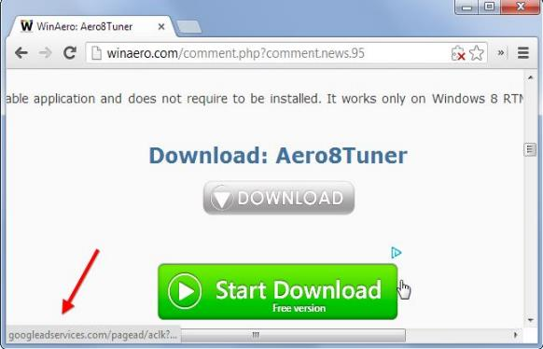
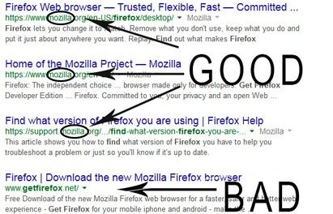

Slide 16
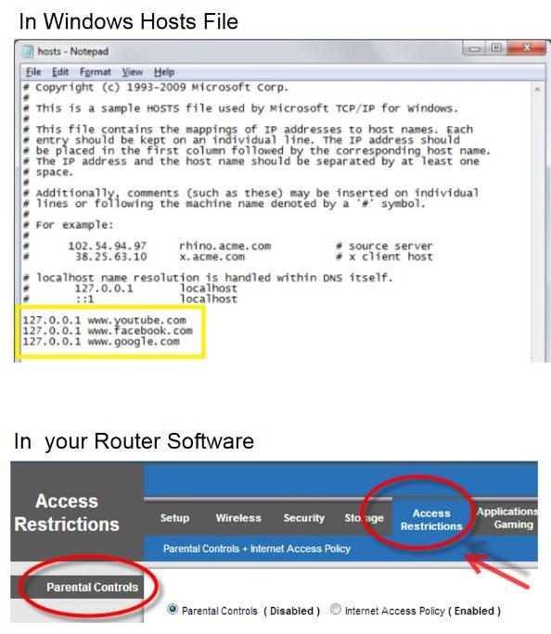
Block It!!!
Using OpenDNS to Block Site Categories or Domains
Using your Router Software to Block Sites
Using the Windows Hosts File
Notes:
Blocking a Website in a local network/machine

Slide 17







Step 1: Open the web site – say, http://gmail.google.com
Step 2: Enter all the required information in the "Create an Account" online form
Step 3: Choose a login name or username for your email address
Step 4: Choosing a password for your email
Step 5: Protecting your Gmail account with a security question
Step 6: Word Verification. You need to enter the characters that you see in the picture above the field in your form
Notes:
Email Services

Slide 18
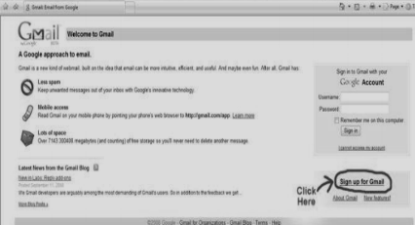
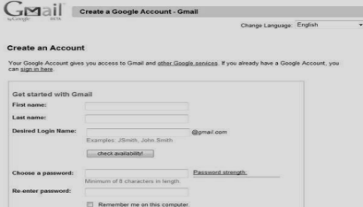
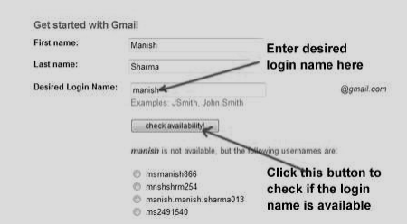
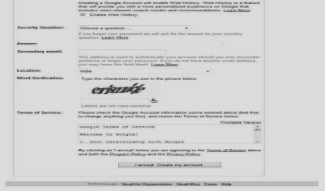
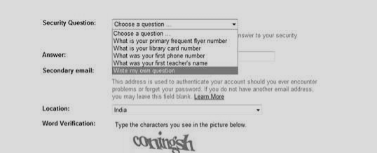
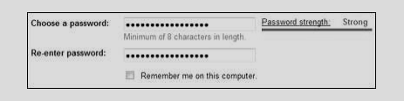
Creation of Email Account:
Step 1: Open the Gmail web site:
Notes:
Setting Up email account

Slide 19

Password
At least 8 characters long
Unique; different from other passwords
Mix of alphabetical and numeric characters
Symbols if the system allows
Make sure to regularly update your recovery email address
Mixture of upper and lowercase
Complex but easy to remember
Difficult for others to guess
Change regularly
Add a phone number to receive password reset codes
WIw7,mstmsritt -> When I was seven, my sister threw my stuffed rabbit in the toilet.
15 Ferrari red -> 1+ferr+red+ari+5 -> 1feredari5
uTVM,TPw55:utvm,tpwstillsecure -> Until this very moment, these passwords were still secure.
Notes:
Password

Slide 20

DON'T write your password down
DON'T share your password with anyone
DON'T include all or part of your username, first name, or last name
DON'T include terms that are significant to you like pet’s name
Social Engineering
Spyware
Key logger
Remote Admin Tool
Trojans
Cracking
Guessing
DON'T include phone number, birthday, number plates
DON'T use alphabet or number sequence
DON'T use a word contained in English or foreign language dictionaries
DON'T use a word spelled backwards
DON'T use a password of all digits, or all the same letter
DON’T Re-use any of your last 10 passwords
Notes:
Password

Slide 21


Copyrights
Sharing copyrighted material to open public without due permission from the owner(s) is a punishable offence under the Copyright Act.
The latest is the arrest of a 25 year old boy who allegedly uploaded the movie ‘Udta Punjab’ in his website for masses to download two days before the release. The cyber cell of Mumbai Police arrested him.
In a similar case the Tamil movie 'Enakku Innoru Per Irukku' which was uploaded on internet before its release. Musician-turned-actor G V Prakash Kumar filed a complaint to the Chennai police for early arrest of the accused.
In 2015 after the petition from the makers of Piku, Delhi High Court passed a piracy restraining orders against websites and cable operators from streaming, broadcasting or publishing online the film Piku without permission.
Copyright protection applies to any work where the creator or owner of the work retains exclusive rights to that work. These works can include movies/ film/TV, music, books and other print material, software, eBooks, website content or layout, visual or theatrical performances, designs, artwork, photographs, graphics, etc.
http://www.lamppostproductions.com/

